Slide 1
Introduction to Database Design
Carsten Schürmann

Slide 2
Administrativa
Carsten Schürmann
Office 4C13, e-mail: carsten@itu.dk
Office Hours
Monday 11:00-12:00 or by appointment
Teaching Staff
Kasper Stig Henningsen
Tobias Erik A. Kristiansen
Manjil Thapa
Homework: 4 assignments
Each assignment has a due date
Exam: 5.1.2016 open book 9:00-13:00
2A12, 2A14, 2A52, 2A54, 3A54

Slide 3
Final Grade
Exam
40%
HW1
15%
HW2
15%
HW3
15%
HW4
15%

Slide 4
Organization
Lectures, 12.00-14.00
AUD1
No preparation expected
Problem sessions
Exercises, 14:00-16.00
4A14, 4A20, 4A22
Current week, no preparation
Previous week, homework (some weeks TA presentation)
Schedule, materials, news, hand-ins: LearnIT

Slide 5

Book

Slide 6
Motivating Example
University administration
students
taking classes
obtaining grades
Question:
How many students are enrolled?
What is my GPA?
Obvious solution:
Paper
+ Easy to use
+ Cheap
Physically sorted
No ad hoc queries
Large physical footprint

Slide 7
Motivating Example
University administration
students
taking classes
obtaining grades
Question:
How many students are enrolled?
What is my GPA?
Next solution:
Computer (flat) files
Comma-separated values
But: Inconvenience, Redundancy, Atomicity, Integrity, Security
123,Thomas
125,Carsten
127,Rasmus
128,Marco
131,Jesper
123,db,10
123,os,7
131,os,12
131,graphics,10

Slide 8
... Or just use a DBMS
Database Management System

Slide 9

MySQL
www.mysql.com
Download MySQL community server
Download MySQL workbench
Others: Oracle/MS SQL-server, Postres, sqlite

Slide 10

How does the DB work?
Logical Organization of Data
Phyiscal Storage of Data

Slide 11
Demo (create table)
mysql>
create table student(
cpr int,
name varchar(20));
+------+---------+
| cpr | name |
+------+---------+
+------+---------+

Slide 12
Demo (insert and select)
mysql>
insert into student values (123,"Thomas");
insert into student values (131,"Jesper");
mysql>
select * from student;
Insert values
Look it up!
+------+--------+
| cpr | name |
+------+--------+
| 123 | Thomas |
| 131 | Jesper |
+------+--------+

Slide 13
Demo (insert and select)
mysql>
create table takes (
cpr int,
cid varchar(10),
grade int);
insert into takes values( 123, "db", 10);
insert into takes values( 123, "os", 7);
insert into takes values( 131, "os", 12);
insert into takes values( 131, "graphics", 10);
select * from takes;
Who takes which class?
+------+----------+-------+
| cpr | cid | grade |
+------+----------+-------+
| 123 | db | 10 |
| 123 | os | 7 |
| 131 | os | 12 |
| 131 | graphics | 10 |
+------+----------+-------+

Slide 14
Demo (join)
More then one table: Do a join!
Example: All students who take “os”
+------+----------+-------+
| cpr | cid | grade |
+------+----------+-------+
| 123 | db | 10 |
| 123 | os | 7 |
| 131 | os | 12 |
| 131 | graphics | 10 |
+------+----------+-------+
+------+--------+
| cpr | name |
+------+--------+
| 123 | Thomas |
| 131 | Jesper |
+------+--------+

Slide 15
Demo (join)
mysql>
select name
from student, takes
where student.cpr = takes.cpr
and takes.cid = "os";
+--------+
| name |
+--------+
| Thomas |
| Jesper |
+--------+

Slide 16
Demo (view)
mysql>
create view fellowship
as ( select cpr, avg(grade)
from takes group by cpr);
select * from fellowship;
+------+------------+
| cpr | avg(grade) |
+------+------------+
| 123 | 8.5000 |
| 131 | 11.0000 |
+------+------------+

Slide 17
Summary
3-level architecture
Physical and Logic Data Independence
Logical level
View 1
View 2
View 3
Tables
Physical level

Slide 18
DB Users
Casual user
Access database directly or through views
“Naïve” User
Indirect through other applications
Application Programmer
Write programs to work with data
Communication through API
Database Administrator
Schema definition/modification Access Control
Integrity Constraints

Slide 19
Application programmer
main(){
.... exec sql “select *
from student” ... }

Slide 20
Database System Architecture
Data Manipulation Language
(DML)
Data Definition Language
(DDL)
Query processing
Query evaluator
DML procedures
Query optimizer
Meta data
Storage manager
Transaction Manager
Buffering Manager
File Manager
Physical Level

Slide 21
Summary
DBMSs: electronic record keepers
Dynamically create content using DDL
Dynamically access data using DML
Logical and physical data independence
Concurrency Control for free!
Recovery for free!

Slide 22
Let’s get started!

Slide 23
Relational Databases [E.F. Codd 1970]
Relational algebra
Algebra (recall from school)
5 + x = 16
iff x = 16 – 5 = 11
Domain: 1,2,3,4,5,6,7….
Operators: + - * div mod

Slide 24
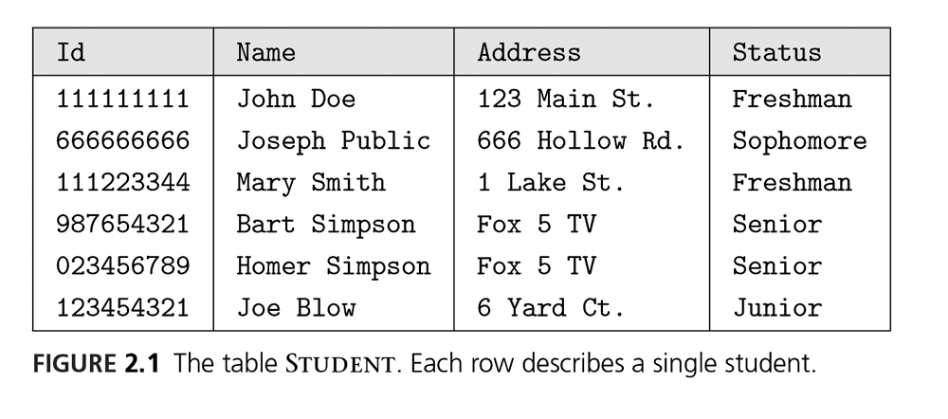
Relational Algebra
Domain: Relations
Operators: intersection, join, projection
attribute
R =
tuple
column

Slide 25
Properties
Relations consists of attributes and tuples
Attributes: Names
Tuples: Set
Elements can only occur once
There is no order among the tuples
Example: {11,3,14} = {3,11,14}
Example: {1,2,3,2} = {1,1,2,3}

Slide 26
Relational Database
Tables-as-relations
(actually they are multi-sets)
Attributes are attached to constraints
Type (DATE, INT, VARCHAR(20) …)
Integrity constraints:
Range of values
Captures other semantic information attached
Relation Schema: Description of columns
Relation Instance: Set of tuples

Slide 27
Course Goals
Use relational algebra
Evaluate relational algebra expressions
Use relational calculus
Model relations as SQL schemas
Apply concepts such as keys, and integrity constraint

Slide 28
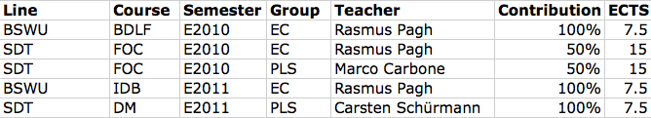
Normalization
Discuss and suggest ways to represent a teaching plan as one or more relations.
Can you avoid (or reduce) duplication of information?

Slide 29
Normalization
Many answers possible
Quality of the answer
Minimize redundancy of information
Number of relations
Size of the tuples and how they fit into blocks
Keeping the database nice and tidy
There is a theory for this!

Slide 30
Course Goals
Find functional dependencies in a relation
Perform decomposition to eliminate unwanted dependencies
Learn about different degrees about normal forms
Be fluent in a DDL

Slide 31
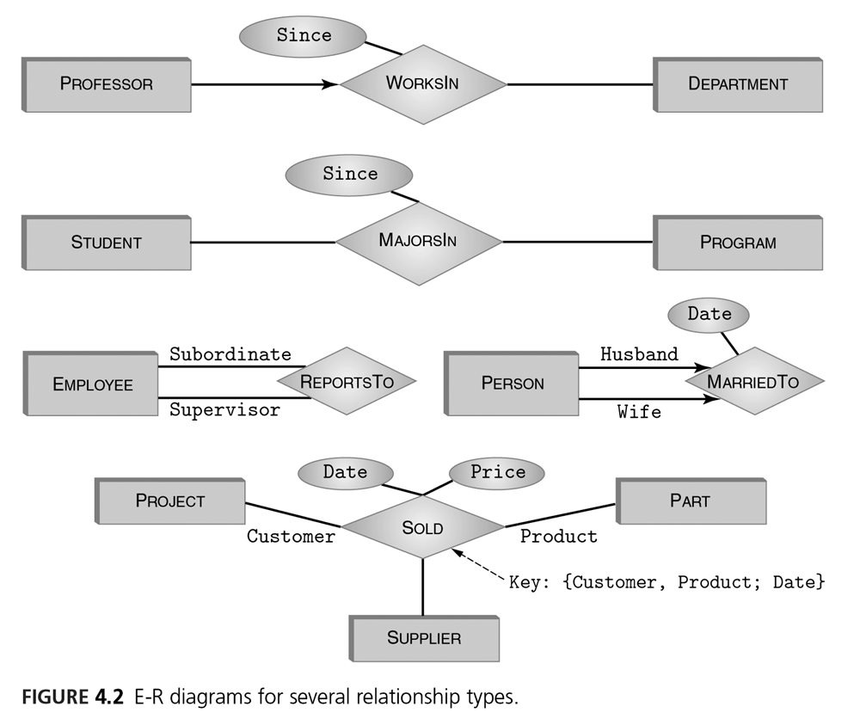
Lifetime of a database
Initial Design
Entity – Relationship Diagram
Maintenance
Schema evolution
Database migration
Discontinuation

Slide 32
Pointers and Keys
Table 3
Table 1
Table 4
Table 2

Slide 33
Course Goals
Define and maintain database designs by E-R modeling
Use concepts such as entity, attribute, key, cardinality, and relationship
Evolve a database in a sound way

Slide 34
SQL [1974]
A Data Manipulation Language (DML)
Structured Query Language (“sequel”)
Queries-as-formulas
Example: Select all movie titles starring “Daniel Craig”, sorted in ascending alpha order.

Slide 35
Select all movie titles starring “Daniel Craig”, sorted in ascending alpha order
Select from Movies and Starring table
Look For “Daniel Craig”
Sort for output
^{select movies.title}
^{from movies, play in}
where play in.name=Daniel Craig
^{and play in.mid = movies.mid}
^{order by movies.title ASC;}

Slide 36
Course Goals
Translate natural language questions into SQL
Complete control of SQL as a DML
Structure complex queries as a sequence of subqueries

Slide 37
Database with Integrity
Constraints
The sum of all accounts is constant!
Each person as one and only one CPR number!
References are sound, for example internal ID numbers.
External Constraints
Financial Database
Internal Constraints

Slide 38
Course Goal
Formulate internal integrity constraints for a database
Referential integrity
Types
Keys
Formulate external integrity constraints

Slide 39
Database Tuning
Order of records is important
Generate output
Relational operation, like join, or cross products
+------+----------+-------+
| cpr | cid | grade |
+------+----------+-------+
| 123 | db | 10 |
| 123 | os | 7 |
| 131 | os | 12 |
| 131 | graphics | 10 |
+------+----------+-------+

Slide 40
Database Tuning
10
+------+----------+-------+
| cpr | cid | grade |
+------+----------+-------+
| 123 | db | 10 |
| 123 | os | 7 |
| 131 | os | 12 |
| 131 | graphics | 10 |
+------+----------+-------+
7
10
12

Slide 41
Database System Architecture
Data Manipulation Language
(DML)
Data Definition Language
(DDL)
Query processing
Query evaluator
DML procedures
Query optimizer
Meta data
Storage manager
Transaction Manager
Buffering Manager
File Manager
Physical Level

Slide 42
Course Goals
Learn the basic algorithms for optimization
B+ - trees
Hash tables
Augment database schemas with additional indexes to speed up queries
Understand algorithms underlying optimization
Learn heuristics on which indexes to create

Slide 43
Transaction Manager
Example:
Two persons with a shared bank account try to withdraw 100 kr at the same time.
1) read balance and store in variable B
2) B:=B-100
3) write B to balance
What could go wrong?

Slide 44
Transaction Manger
Balance
1000
1000
1000
900
900
900
800
B := read Balance
B := B - 100
write B to balance
B := read balance
B := B - 100
write B to balance

Slide 45
Crazy Interleavings
Balance
1000
1000
1000
1000
1000
900
900
B := read Balance
B := read balance
B := B - 100
B := B - 100
write B to balance
write B to balance

Slide 46
Transaction Manager
Atomicity: A transaction runs to completion or has no effect at all
Consistency: After a transaction completes, the integrity constraints are satisfied
Isolation: Transactions executed in parallel has the same effect as if they were executed sequentially
Durability: The effect of a committed transaction remains in the database even if the computer crashes.

Slide 47
Course Goals
Be able to explain how modern transaction managers work
Learn about algorithms that guarantee ACID properties

Slide 48
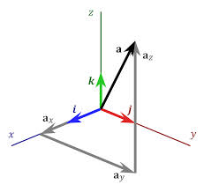
Data Analytics
Data
Vectors in a vector space
Dimensions
Examples
Classes
Grades
Students

Slide 49
Course Goals
Create databases for analytics
Learn basic machine learning algorithms
Find patterns in unstructured data

Slide 50

Database of Choice for this Course
More information on LearnIT

